Slide 1

CHALAPATHI INSTITUTE OF ENGINEERING & TECHNOLOGY
DEPARTMENT OF ELECTRONICS AND COMMUNICATION ENGINEERING
Revolutionizing Skin Disease Diagnosis: Convolutional Neural Networks
Batch No : 09
Under Guidence Of
Mrs.A.Soujanya (M.Tech)
Asst.Professor(ECE)
Submitted by:
CH.Keerthi (Y20ECE044)
B.Dinesh Ajai (Y20ECE015)
D.Sai Kiran (Y20ECE045) D.Srikanth (Y20ECE049)

Slide 2



Contents :
Introduction
Skin Disease Diagnosis Challenges
The Role Of Convolutional Neural Networks Training CNN With Dermatology Data
CNN vs. Human Dermatologists
Future Applications Of CNN in Dermatology Enhancing Acess To Dermatology Care
The Future Of Dermatology Diagnosis Conclusion

Slide 3

Introduction
In this presentation, we will explore the revolutionary impact of Convolutional Neural Networks on . We will delve into the potential of AI in transforming the ﬁeld of dermatology.

Slide 4


Skin Disease Diagnosis Challenges
Diagnosing can be complex due to variations in appearance and symptoms. Traditional methods often rely on visual inspection, leading to misdiagnosis and delays in treatment.

Slide 5
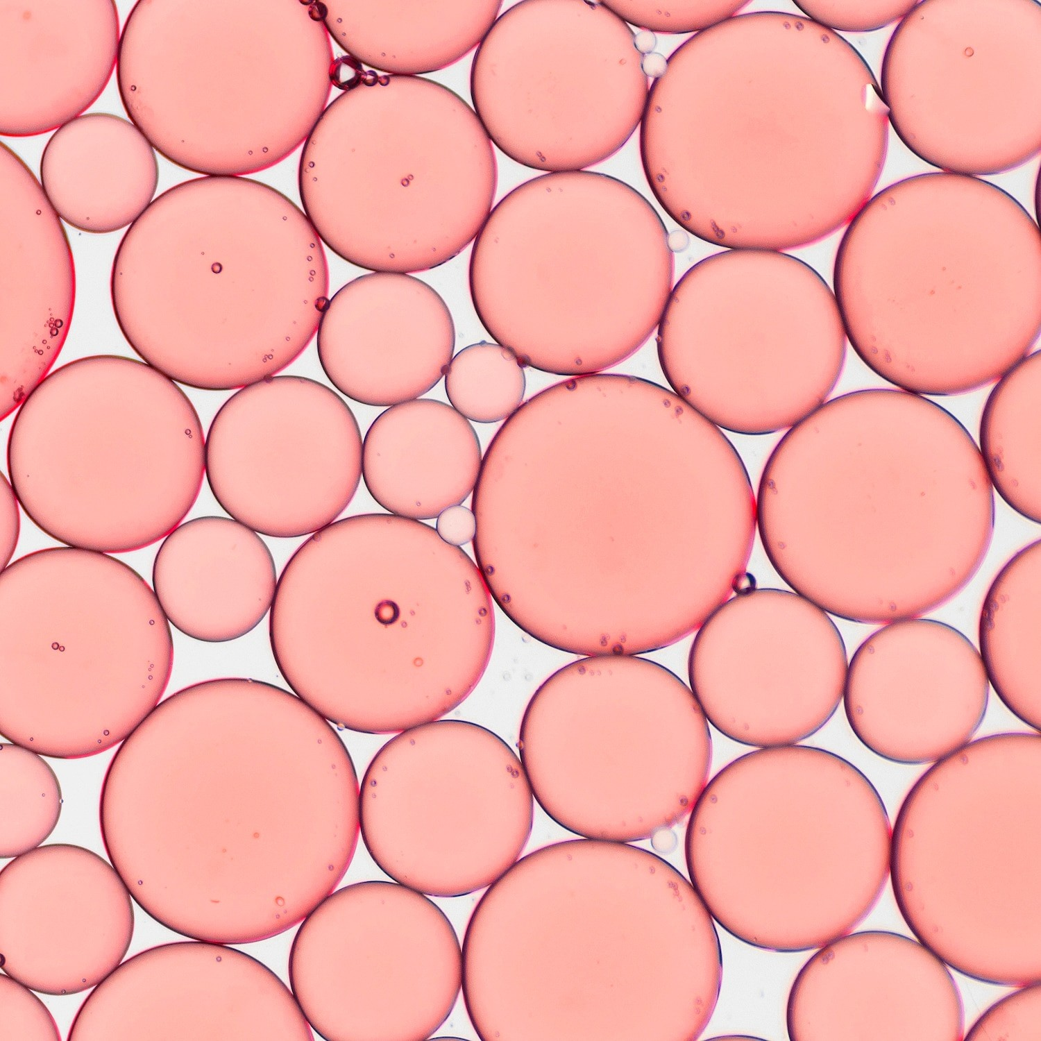

The Role of Convolutional Neural Networks
Convolutional Neural Networks (CNNs) have emerged as a in skin disease diagnosis. Their ability to analyze complex patterns in skin images has paved the way for more accurate and efﬁcient diagnosis.

Slide 6

Training CNNs with Dermatology Data
Training CNNs requires a vast dataset of I identify various skin conditions. The quality and diversity of the dataset directly impact the network's diagnostic accuracy.

Slide 7
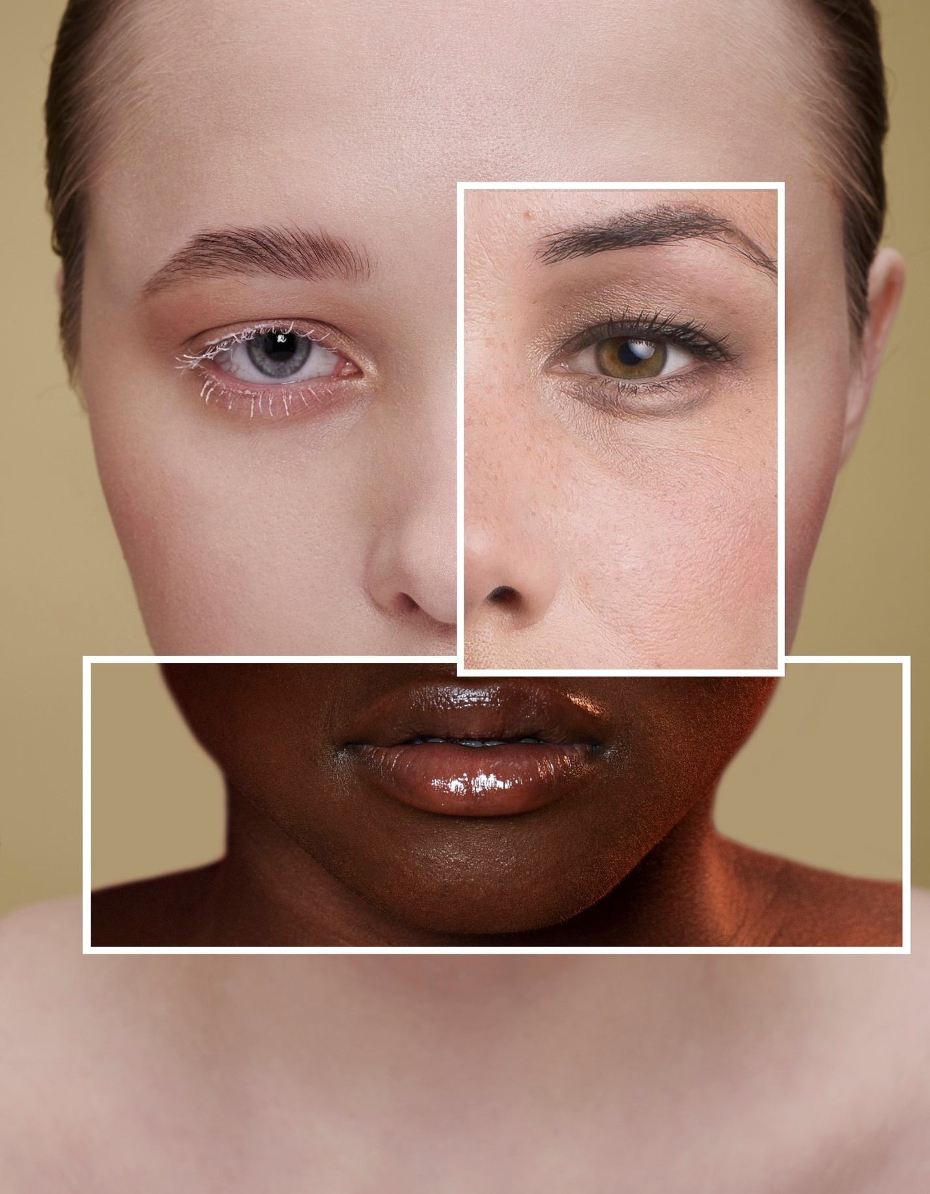


CNNs vs. Human Dermatologists
CNNs have demonstrated comparable or even superior performance to I in diagnosing skin diseases. Their consistent accuracy and efﬁciency have the potential to revolutionize dermatological practice.

Slide 8


CNNs enable of skin conditions, offering immediate feedback to healthcare providers. This capability has the potential to expedite treatment decisions and improve patient outcomes.

Slide 9


Despite their potential, CNNs face challenges such as and ethical considerations related to patient privacy and data security. Addressing these issues is crucial for the ethical implementation of AI in dermatology.

Slide 10

Future Applications of CNNs in Dermatology
The future of CNNs in dermatology extends beyond diagnosis, with potential applications in , personalized skincare, and predictive analysis of skin conditions. The possibilities are vast and promising.

Slide 11
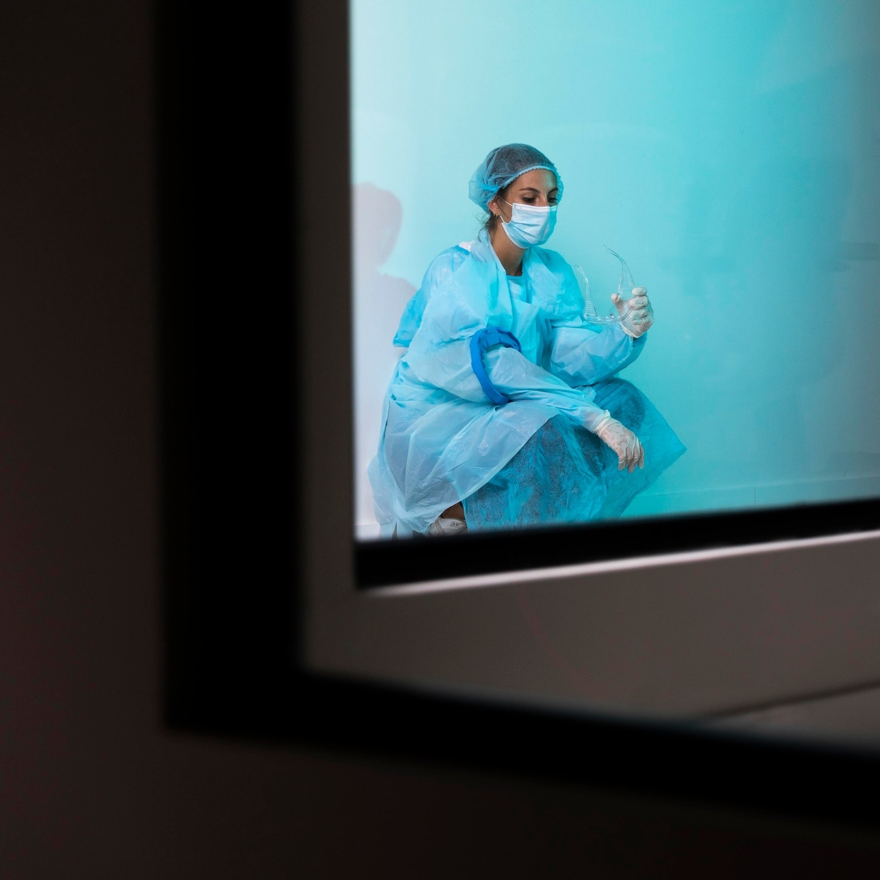


Enhancing Access to Dermatological Care
CNNs have the potential to t to dermatological care, particularly in underserved areas. Tele-dermatology powered by AI can bridge the gap and provide diagnostic support to remote communities.

Slide 12


The Future of Dermatological Diagnosis
The future of dermatological diagnosis is intricately linked with the advancements in AI, particularly CNNs. Embracing this technology will lead to more precise, efﬁcient, and accessible dermatological care.

Slide 13


Conclusion
In conclusion, Convolutional Neural Networks offer a in skin disease diagnosis, promising enhanced accuracy, efﬁciency, and accessibility.
Embracing AI in dermatology holds immense potential for transforming patient care and outcomes.

Slide 14
Thank You For Everyone..!
Do You Have Any Questions...?

